Slide 1
The Communications Lab @ HGSE Presents…
The Power of Your
Digital Brand
Leveraging Multimedia to Curate a Career Oriented Professional Profile
April 2021

Slide 2



# ABOUT US
WHAT
WE DO
We are a HGSE resource created to help graduate students develop their presentation skills and to provide a space and opportunity for students to cultivate their oral and visual communication skills
1
2
3
Workshops
Webinars
Consultations
Note: Photos included in this presentation are from Unsplash.com and Flickr.com. Unsplash is a free online service that provides professional quality photos which can be used for commercial or non-commercial purposes without the need of permission or credit. Flickr.com is a photograph management and sharing website. Note that only some photographs on Flickr can be used without permission; be sure to check each photograph’s individual copyright information.

Slide 3
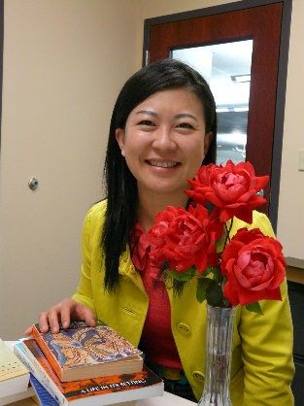
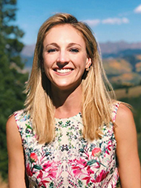
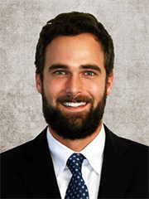
# ABOUT US
WHO WE ARE
Ning Zou
MG Prezioso
Dylan J. Lukes
Associate Director for Student Academic Services & Learning Design and a research librarian. She oversees Gutman Library's Writing Services and the Communications Lab in addition to providing research consultations and leading the library's learning design projects
Doctoral candidate at Harvard University and HGSE. MG studies the intersection of psychology and literature. Specifically, she is interested in the process of children's narrative absorption, as well as how literature contributes to students' moral development and identity formation.
Doctoral candidate and Presidential Scholar at Harvard University and HGSE. He studies the economics of education with a focus on technology and learning.
https://communicate.gse.harvard.edu/communicationslab

Slide 4
# YOUR DIGITAL BRAND
WORKSHOP AGENDA
01
02
MOTIVATION
INTRO TO YOUR
DIGITAL BRAND
03
04
LINKEDIN DEEP DIVE
DIGITAL BRAND TIPS

Slide 5
# YOUR DIGITAL BRAND
WORKSHOP AGENDA
01
02
MOTIVATION
INTRO TO YOUR DIGITAL BRAND
03
04
LINKEDIN DEEP DIVE
DIGITAL BRAND TIPS

Slide 6

# MOTIVATION
YOUR DIGITAL BRAND
Professional vs. Personal¹
Your professional digital brand varies across several key dimensions from your personal online persona. While both are important, the focus of today’s workshop is the former.
UX ENGENEER
Ut et pulvinar odio. Nam condimentum nisl
1
Audience: Employers, Networking
2
Content: Bio, Resume, Language, Tone
3
Visibility: Public vs. Private
1. Doyle, A. (2019). How to Create a Professional Brand: Best Tips for Creating a Professional Brand. Retrieved from https://www.thebalancecareers.com/how-to-create-a-professional-brand-2059761

Slide 7

# MOTIVATION
ACTIVITY PROMPT
Let’s see what your employer facing digital profile looks like today.
Google yourself.
1
2
3
4
WHO?
Who do you see?
Are you the first person that shows up in the search results?
Do you show up at all?
WHAT?
What do you see?
What type of content is emphasized?
Personal or Professional or both?
WHERE?
Where do you see it?
Name the sources your name is associated with?
Ex: Facebook, LinkedIn, Personal Webpage, etc.
HOW?
How many times do you see yourself?
Are there multiple webpages and links?

Slide 8
# MOTIVATION
ACTIVITY PROMPT
IDEAL²
Presence
  Your Professional Webpage
  LinkedIn
  Twitter Handle
  Links to Publications
  Professional / Industry Blogs
  Links to Employer’s Website
Order
  Systematic
  Your profiles and links are first
SUB-OPTIMAL²
Presence
  No presence
  The wrong presence: private > professional
  No identification: picture, video
Order
  No order
  Your profiles and links fall outside of the top search results
The goal is NOT to erase our digital selves altogether, but to leverage online tools and multimedia as a means to promoting ourselves and being seen professionally
2. Doyle, A. (2019). How to Create a Professional Brand: Best Tips for Creating a Professional Brand. Retrieved from https://www.thebalancecareers.com/how-to-create-a-professional-brand-2059761

Slide 9
# YOUR DIGITAL BRAND
WORKSHOP AGENDA
01
02
MOTIVATION
INTRO TO YOUR DIGITAL BRAND
03
04
LINKEDIN DEEP DIVE
DIGITAL BRAND TIPS

Slide 10

STEP 1
STEP 2
# INTRO TO YOUR DIGITAL BRAND
YOUR DIGITAL BRAND
REINVENTING
YOURSELF³
Define your goals and acquire skills
Distinguish yourself
Oftentimes, graduate school is used to transition from one career to the next. How you do so matters. Having an overarching strategy and knowing how to promote your professional self online could make all the difference when trying to land your dream job.
STEP 5
Promote
STEP 3
Develop your transition narrative
STEP 4
Leverage digital media
3. Clark, D. (2011). Reinventing Your Personal Brand. Harvard Business Review, 89(3), 78–81.
Notes:
Source: Clark (2011)

Slide 11

# INTRO TO YOUR DIGITAL BRAND
DIGITAL MEDIUMS
Personal Website
Social Networks
LinkedIn
Others
1
2
3
4

Slide 12
# INTRO TO YOUR DIGITAL BRAND
DIGITAL MEDIUMS
Personal Website
Personal Website
Social Networks
LinkedIn
Others
1
2
3
4

Slide 13

# INTRO TO YOUR DIGITAL BRAND
PERSONAL WEBSITE
Content
  Bio, published work, accomplishments
URL
  Use your name to increase searchability
Copyright
  Include copyright disclaimer on your website – takes many shapes and forms
  Reach out to Carol Kentner, HGSE Digital Scholarship Librarian, for additional details about CC licensing and copyright
Title
here

Slide 14
# INTRO TO YOUR DIGITAL BRAND
DIGITAL MEDIUMS
Social Networks
Personal Website
Social Networks
LinkedIn
Others
1
2
3
4

Slide 15
# INTRO TO YOUR DIGITAL BRAND
SOCIAL NETWORKS⁴
Facebook + IG + Others
  Tagging and Privacy Settings
Twitter
  Goal: connect, talk and build meaningful professional relationships; be targeted
  Employ social media manager tools to control/filter endless supply of tweets (e.g. HootSuite, Later, Sendible, SocialOomph, Social Clout)
  Create “Twitter Lists” with appropriate names / Live Chats / Retweeted
  Be active, follow prospective employers
Title
here
4. Samuel, A. (2013). Work Smarter with Twitter and HootSuite. Harvard Business School Cases, 1.
Notes:
Alex Samuel (2013)

Slide 16
# INTRO TO YOUR DIGITAL BRAND
DIGITAL MEDIUMS
Others
Personal Website
Social Networks
LinkedIn
Others
1
2
3
4

Slide 17
# INTRO TO YOUR DIGITAL BRAND
Other Mediums⁵
Blogs
  Goal: Professionally oriented well written blog posts
  Highlights skills and expertise in a given professional domain
Email
  Professional signature line that includes 1) name; 2) title; 3) credentials; 4) links
Chat Forums
  Good idea to update privacy settings and make sure posts are anonymized
  Linked back to identifying info?
Title
here
5. Doyle, A. (2019). How to Create a Professional Brand: Best Tips for Creating a Professional Brand. Retrieved from https://www.thebalancecareers.com/how-to-create-a-professional-brand-2059761
Notes:
Alex Samuel (2013)

Slide 18
# YOUR DIGITAL BRAND
WORKSHOP AGENDA
01
02
MOTIVATION
INTRO TO YOUR DIGITAL BRAND
03
04
LINKEDIN DEEP DIVE
DIGITAL BRAND TIPS

Slide 19

# LINKEDIN DEEP DIVE
Curating Your LinkedIn Profile⁶
1
2
3
4
OPTIMIZE YOUR HEADLINE
TELL YOUR STORY
TAILOR YOUR EXPERIENCES
ADD RECS +
Setup your headline to maximize your impact when employees search your name
Akin to your online elevator pitch; short and impactful
Go beyond describing or listing tasks
State your value through the results or impact of what you do
Focus on only relevant accomplishments and professional experiences
Be concrete; be specific
Avoid focusing on responsibilities
Make them relevant to the jobs you are applying for
Provide direction to your recommenders
Other profile pieces
6. Heifetz, J. (2015). How to Use Your LinkedIn Profile to Power a Career Transition. Harvard Business Review Digital Articles, 2–5.
Notes:
Heifetz (2015)

Slide 20
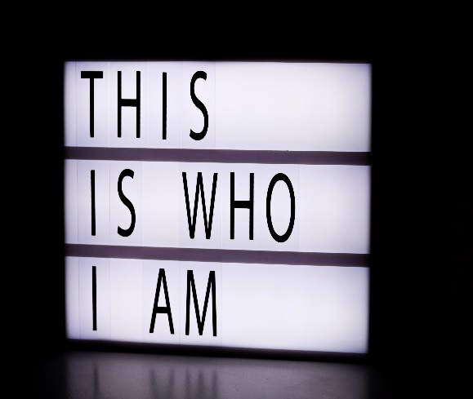
KEEP IT SHORT AND SWEET
You only have ~120 characters
# LINKEDIN DEEP DIVE
ª
STEP 1
Optimize Your
Headline
PRIORITIZE & MAKE IT COUNT
What do you most want a prospective employer to remember about you? This is your “hook” to get employers to click into your profile.
^{b}
By default, this space is reserved for your current job description, instead make it an eye-catching headline about your professional self
HONEST ASSESSMENT
Search for people in LinkedIn similar to you
How does your headline compare to your peers?
Honest Assessment – Do you stand out?
  * Would you be compelled to click into your profile?
  * Why or why not?
Notes:
Heifetz (2015)

Slide 21

CONVEY YOUR VALUE ADD
Your descriptions of what you do should help your listener learn how you can add value
ª
# LINKEDIN DEEP DIVE
STEP 2
Tell Your
Story
WHAT’S YOUR IMPACT THROUGH WHAT YOU DO
Think of this as your “tag line”
^{b}
This section is akin to your digital elevator pitch. Use this space to tell employers why you’re unique, what you’ve accomplished and what you want to do next
WHAT’S NEXT?
Tell prospective employers your next steps and goals. Be specific and passionate. How do prospective employers fit?
^{c}
CRAFT YOUR NARRATIVE
This is your opportunity to tell a cohesive story about your employment history that bring unity to any potentially disparate work experiences.
Notes:
Heifetz (2015)

Slide 22
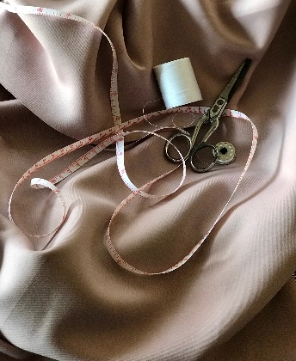
FIRST PERSON
Make sure to your job descriptions are in first person
ª
# LINKEDIN DEEP DIVE
STEP 3
Tailor Your
Experiences
BE RELEVANT
Undoubtedly you have many accomplishments and experiences, but be take time to separate the wheat from the chaff and include only what’s relevant for prospective employers
^{b}
This is your time to shine, but be targeted. Tailor your work experiences to your future employers emphasizing only the relevant accomplishments and skills and omitting all others
AVOID LISTING RESPONSIBILITIES
Although important, time and space is limited. Focus instead on relevant accomplishments.
Examples
^{c}
OVERHAUL YOUR JOB EXPERIENCES
Go through your LinkedIn profile and clean up your job descriptions. If possible, remove jobs that aren’t relevant to your prospective employers.
Notes:
Heifetz (2015)

Slide 23

CHOOSE WISELY
Be targeted and make them relevant to the positions you’re applying for.
ª
# LINKEDIN DEEP DIVE
STEP 4
Add
Recs +
GIVE DIRECTION
People are busy. Help your recommenders out by providing them with the exact prospective positions and the specific skills you’d like highlighted
^{b}
This is the final stage. Leverage your hard earned network. Now is the time to reach out to past employers and bosses for recommendations.
KEEP IT WITHIN REASON
You only need a few high impact recommendations. Don’t overdo it here. Prioritize quality over quantity.
Examples
^{c}
FINISHING TOUCHES
Add a professional headshot and include other media as appropriate
Be active – post, join groups, comment on posts (be professional)
Notes:
Heifetz (2015)

Slide 24
# YOUR DIGITAL BRAND
WORKSHOP AGENDA
01
02
MOTIVATION
INTRO TO YOUR DIGITAL BRAND
03
04
LINKEDIN DEEP DIVE
DIGITAL BRAND TIPS

Slide 25
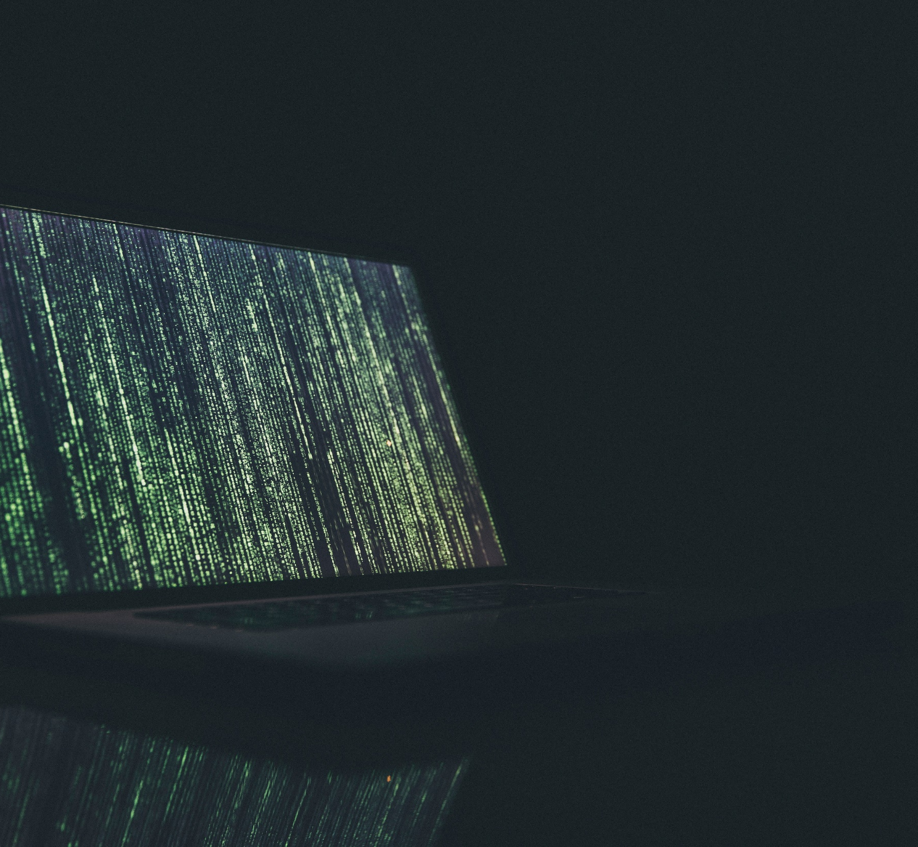
# DIGITAL BRAND TIPS
TIP #1
“Keep it Fresh”
Avoid stale profiles⁷
  Actively manage your profiles
  Update your bio once or twice every year
  Make sure your descriptions are curated for the jobs you want
Schedule Time
  Schedule time
  Do it with a friend!
Title
here
7. Fineman, M. (2015). What Your Professional Bio Needs to Get Noticed. Harvard Business Review Digital Articles, 2–4.
Notes:
Fineman (2015)

Slide 26
# DIGITAL BRAND TIPS
TIP #2
“Link Your Work”
Make it Easy⁸
  Employers shouldn’t have to dig to find evidence of your accomplishments or publications
  Link them!
Avoid Broken Links
  Make sure they’re active and trackable
  bit.ly links work great for this
Title
here
8. Fineman, M. (2015). What Your Professional Bio Needs to Get Noticed. Harvard Business Review Digital Articles, 2–4.
Notes:
Fineman (2015)

Slide 27
# DIGITAL BRAND TIPS
TIP #3
“Set Boundaries”
Delineate the personal from the professional
  There should be a clear separation between your personal and your professional profiles
  Check your privacy settings for both professional profiles and personal
Complete Erasure is Challenging
  Be aware that scrubbing your personal profile may not lead to complete erasure
Notes:
Fineman (2015)

Slide 28
# DIGITAL BRAND TIPS
TIP #4
“Be Consistent”
Personal Bio / Online Elevator Pitch⁹
  Bio needs to tell the same story across multiple digital mediums
  Helps convey clearly who you are
  Types: Two-line, Short, Long Bios
Others
  Professional Headshot
  Resume / Experience / Skills
Title
here
9. Fineman, M. (2015). What Your Professional Bio Needs to Get Noticed. Harvard Business Review Digital Articles, 2–4.
Notes:
Fineman (2015)

Slide 29
# DIGITAL BRAND TIPS
TIP #5
“Use Active Voice”
Avoid the passive voice, be active¹⁰
  Downplaying achievements
  “A promotion to Senior Analyst was awarded to me” vs. “ I was promoted to Senior Analyst”
Be Confident
  Avoid using words like “attempting” or “trying”
  Instead opt for “I’m doing this”
10. Fineman, M. (2015). What Your Professional Bio Needs to Get Noticed. Harvard Business Review Digital Articles, 2–4.
Notes:
Fineman (2015)

Slide 30

TIP #1
TIP #2
# DIGITAL BRAND TIPS
SUMMARY
Refining Your Digital Brand
Keep it Fresh
Link Your Work
Center your digital profile around these tips and you will be well on your way to winning over your future employer and effectively communicating your professional value. This is not an exhaustive list, but it is a great place to start as you strive to create and polish your digital profile across multiple mediums.
TIP #3
Set Boundaries
TIP #5
Use Active Voice
TIP #4
Be Consistent

Slide 31
THANK YOU
#HGSE COMMLAB
https://communicate.gse.harvard.edu

Slide 32
References
Clark, D. (2011). Reinventing Your Personal Brand. Harvard Business Review, 89(3), 78–81.
Clark, D. (2014). How to Promote Yourself Without Looking Like a Jerk. Harvard Business Review Digital Articles, 2–4.
Doyle, A. (2019). How to Create a Professional Brand: Best Tips for Creating a Professional Brand. Retrieved from https://www.thebalancecareers.com/how-to-create-a-professional-brand-2059761
Dutta, S. (2010). What’s Your Personal Social Media Strategy? Harvard Business Review, 88(11), 127–130.
Fineman, M. (2015). What Your Professional Bio Needs to Get Noticed. Harvard Business Review Digital Articles, 2–4.
Gallo, A. (2011). Boost Your Career with Social Media: Tips for the Uninitiated. Harvard Business School Cases, 1.

Slide 33
References
Heifetz, J. (2015). How to Use Your LinkedIn Profile to Power a Career Transition. Harvard Business Review Digital Articles, 2–5.
Samuel, A. (2013). Work Smarter with Twitter and HootSuite. Harvard Business School Cases, 1.

