Slide 1
The Communications Lab @ HGSE Presents…
How to Give an Effective
Elevator Pitch
Creating and Communicating Your Vision in Under 1 Minute
October 2020

Slide 2



# About Us
WHAT
WE DO
We are a HGSE resource created to help graduate students develop their presentation skills and to provide a space and opportunity for students to cultivate their oral and visual communication skills
1
2
3
Workshops
Webinars
Consultations
Note: all photos included in this presentation are from Unsplash.com, a free online service that provides professional quality photos which can be used for commercial or non-commercial purposes without the need of permission or credit.

Slide 3
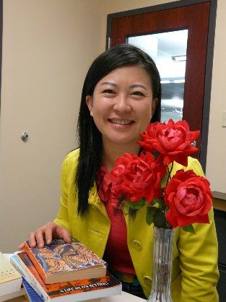

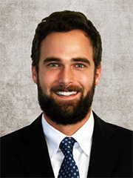
# About Us
WHO WE ARE
Ning Zou
MG Prezioso
Dylan J. Lukes
Associate Director for Student Academic Services & Learning Design and a research librarian. She oversees Gutman Library's Writing Services and the Communications Lab in addition to providing research consultations and leading the library's learning design projects
Doctoral candidate at Harvard University and HGSE. MG studies the intersection of psychology and literature. Specifically, she is interested in the process of children's narrative absorption, as well as how literature contributes to students' moral development and identity formation.
Doctoral candidate and Presidential Scholar at Harvard University and HGSE. He studies the economics of education with a focus on technology and learning.
https://communicate.gse.harvard.edu/communicationslab

Slide 4
# EFFECTIVE ELEVATOR PITCHES
WORKSHOP AGENDA
01
02
MOTIVATION
INTRO TO ELEVATOR PITCHES
03
04
ELEVATOR PITCH TIPS
PRACTICE, PRACTICE, PRACTICE

Slide 5
# EFFECTIVE ELEVATOR PITCHES
WORKSHOP AGENDA
01
02
MOTIVATION
INTRO TO ELEVATOR PITCHES
03
04
ELEVATOR PITCH TIPS
PRACTICE, PRACTICE, PRACTICE

Slide 6

# MOTIVATION
AN ELEVATOR PITCH
WHY SHOULD I CARE?
PLANNING
YOU NEED TO CLEARLY …
1
“Promote Yourself”
UX ENGENEER
Ut et pulvinar odio. Nam condimentum nisl
2
“Promote Your Idea”
3
“Promote Your Research”
…IN 60 SECONDS

Slide 7
# EFFECTIVE ELEVATOR PITCHES
WORKSHOP AGENDA
01
02
MOTIVATION
INTRO TO ELEVATOR PITCHES
03
04
ELEVATOR PITCH TIPS
PRACTICE, PRACTICE, PRACTICE

Slide 8
# INTRO TO ELEVATOR PITCHES
AN ELEVATOR PITCH
WHAT IS IT?
PLANNING
A 60 second high-level overview of your story that effectively details who you are, your impact, your uniqueness and goals
May need to deliver it under pressure and without warning
Contexts vary far and wide. Some include:
  Job Recruiting
  Connecting with new colleagues
  Recruiting stakeholders (for business, for a cause, etc.)
  Promoting your research at a conference
UX ENGENEER
Ut et pulvinar odio. Nam condimentum nisl

Slide 9

# INTRO TO ELEVATOR PITCHES
AN ELEVATOR PITCH IN 4 STEPS
1
2
3
4
WHO YOU ARE
WHAT YOU DO
WHY YOU ARE UNIQUE
GOAL FOR PITCH
Keep it short and sweet
Go beyond describing or listing tasks
State your value through the results or impact of what you do
Another opportunity to showcase your value-add
Put a pause on being humble or self-deprecating and show the unique benefits you bring
Your opportunity to highlight how you are different or better (context dependent)
What is the goal of your elevator pitch?
Who is your pitch for and why are you giving it?
Personal vs. Professional Elevator Pitches

Slide 10

Remember to smile and show enthusiasm
KEEP IT SHORT AND SWEET
This should be a maximum 10-15 seconds
# INTRO TO ELEVATOR PITCHES
ª
STEP 1
WHO
YOU ARE
This can be a statement or question that grabs your audiences attention
PRIORITIZE & MAKE IT COUNT
What do you most want the listener to remember about you? This is the “hook” of your pitch.
^{b}
One or two sentence intro to kick off your elevator pitch and introduce the listener to who you are
Examples
Ex 1: Hi, my name is Dylan, and I am a Ph.D. Candidate at Harvard studying education policy and economics. I’m an ex-management consultant that cares about using data and economic theory to impact positive social change.
Ex 2: Community college students are often frustrated, confused or intimated by the opaque process of transferring to a 4-year college. I’m passionate about solving this problem for all students, but particularly for first-generation, low income students with limited support and guidance.

Slide 11
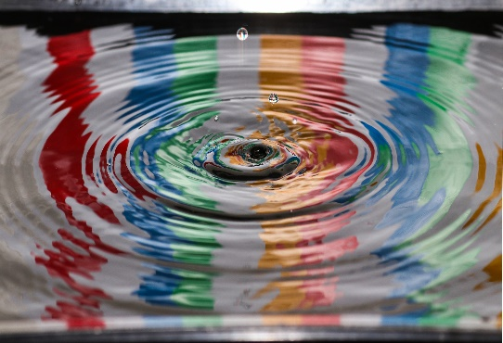

WHAT’S YOUR IMPACT THROUGH WHAT YOU DO
Think of this as your “tag line”
# INTRO TO ELEVATOR PITCHES
ª
STEP 2
WHAT
YOU DO
CONVEY YOUR VALUE ADD
Your descriptions of what you do should help your listener learn how you can add value
^{b}
Now is not the time to list all your job responsibilities and what they entail. Use this stage to go beyond simply describing what you do and highlight the impact of it
Examples
Ex 1: “I use advanced statistical techniques to answer challenging educational policy questions that lack a clear consensus or robust causal evidence. My research questions are informed by my passion for economics and my belief that education is a gateway to a more prosperous future.”
Ex 2: “I created an app to tackle this problem. It is an advanced data aggregation and analytics platform that generates academic plans and trackers tailored to a student’s strengths and weaknesses to aid them in earning a bachelor’s degree via the community college route.”

Slide 12

HOW ARE YOU DIFFERENT?
What unique skills, experiences and perspective do you bring to the organization or community?
# INTRO TO ELEVATOR PITCHES
ª
STEP 3
WHY YOU
ARE UNIQUE
HOW ARE YOU BETTER?
What benefits do you bring to the organization or community that others may not?
^{b}
This is your time to let your unique self shine. Give your listener an inside track to how your different and why it matters.
Examples
Ex 1: “My unique set of analytical skills developed during my time in academics is complemented by a suite of social and communications skills sharpened from my time as a management consultant. In a world that increasingly values data analytics and team based skills, I have both.”
Ex 2: “My platform is the first of its kind and will be licensed to high schools and community colleges in California for $10 per year. This will alleviate the burden placed on academic counselors and provide cost effective support at nationally competitive pricing for low-income, first gen students.”

Slide 13

GOALS ARE CONCRETE & DEFINED
# INTRO TO ELEVATOR PITCHES
ª
STEP 4
WHAT’S
YOUR GOAL
GOALS ARE REALISTIC
^{b}
This is the final stage. Now is the time to describe your immediate goals and make clear what you are asking of the listener.
Examples
Ex 1: “I read that your organization is involved in education policy research and provides strategic support to state and federal level education agencies. Can you tell me how someone with my experience may fit into your organization?”
Ex 2: “With 100+ community colleges and 1300 + California high schools, and no direct competitors, my app aims to capture 10% of high schools and 25% of community colleges as clients for a total revenue of $1M + per year. This is an opportunity for you to invest in an ed-tech start up at the ground-level while making 4-year institutions more accessible to all.”

Slide 14
# EFFECTIVE ELEVATOR PITCHES
WORKSHOP AGENDA
01
02
MOTIVATION
INTRO TO ELEVATOR PITCHES
03
04
ELEVATOR PITCH TIPS
PRACTICE, PRACTICE, PRACTICE

Slide 15

# ELEVATOR PITCH TIPS
TIP #1
“Be Succinct”
Avoid the nitty-gritty details (for now)
  Too much detail may lose your audience
  You have a short-time to make an impression and hook your audience, don’t linger
Make it 60 seconds or less
  This is not a hard and fast rule
  Adjust to your audience as needed
Title
here

Slide 16
# ELEVATOR PITCH TIPS
TIP #2
“Make it Authentic”
This is NOT a memorized monologue
  Find the balance between ad lib and rote memorization
Make your audience feel SPECIAL
  Yes, this is a targeted speech that follows a template…BUT allow yourself some freedom to let your unique personality show
  Remember you are having a conversation
Title
here

Slide 17
# ELEVATOR PITCH TIPS
TIP #3
“Be Passionate”
Good content and structure may not be enough
  Your audience might be impressed by your credentials, experience and acumen but does your story MOVE them?
Create a spark. Hook your listener. Make an impact.
  Excitement begets excitement
  If you’re not excited, your listener probably won’t be either

Slide 18
# ELEVATOR PITCH TIPS
TIP #4
“Be Confident”
Hone your non-verbal communication
  Hand gestures (e.g. “the box”, “pyramid hands”, “holding the ball”, “palms up/ palms down”)
  Stances (e.g. “wide stance”)
  Posture
Nerves
  Being nervous ≠ lacking confidence
  Public speaking can be tough, but practice can help overcome nerves
Title
here

Slide 19
# ELEVATOR PITCH TIPS
TIP #5
“Prepare & Practice”
Preparation
  What are you going to say? (content)
  When are you going to say it? (structure)
  How long does it take it say (timing)
Practice
  Developing and refining your 60 second pitch takes practice and iteration
  Rehearse by section and then combine

Slide 20

TIP #1
TIP #2
# ELEVATOR PITCH TIPS
SUMMARY
Tips for Success
Be Succinct
Make it Authentic
Center your elevator pitch around these tips and you will be well on your way to winning over your audience and effectively communicating your vision in under 60 seconds. This is not an exhaustive list, but it is a great place to begin as you strive to create a polished and impactful pitch.
TIP #3
Be Passionate
TIP #5
Prepare & Practice
TIP #4
Be Confident

Slide 21
# EFFECTIVE ELEVATOR PITCHES
WORKSHOP AGENDA
01
02
MOTIVATION
INTRO TO ELEVATOR PITCHES
03
04
ELEVATOR PITCH TIPS
PRACTICE, PRACTICE, PRACTICE

Slide 22

# PRACTICE, PRACTICE, PRACTICE
PRACTICE PROMPT
You’re at a conference talk on campus. You find yourself with the opportunity to talk with the headliner after their presentation. Time to put your polished elevator pitch to good use!
1
2
3
4
Create groups (2-3)
Give your elevator pitch without preparation
Each person (if comfortable) should give this a try
Prepare
Using the template we provided prepare each elevator pitch stage
You can write this down and use script if needed
Take 2: Elevator Pitch
Give your prepared elevator pitch
Each person (if comfortable) should give this a try
Feedback
Provide feedback to your peers
What worked?
What didn’t?

Slide 23
THANK YOU
#HGSE COMMUNICATIONS LAB
https://communicate.gse.harvard.edu/communicationslab

Slide 24
References
Gallo, Carmine. (2018). “The art of the elevator pitch”. Accessed from: https://hbr.org/2018/10/the-art-of-the-elevator-pitch
Harvard Business School. (2020). “HBS Elevator Pitch Builder”. Accessed from: http://about.mjumbepoe.com/elevator-pitch-builder/
Neely, Joe. (2017). “Top 7 Killer Elevator Pitch Examples”. Access from: https://blog.toggl.com/elevator-pitch-examples/
UC-Davis. (Undated) “The 30 Second Elevator Speech”. Accessed from: http://sfp.ucdavis.edu/files/163926.pdf
Wezowski, Kasia. (2017). “6 ways to look more confident during a presentation”. Harvard Business Review. Accessed from: https://hbr.org/2017/04/6-ways-to-look-more-confident-during-a-presentation

