Slide 1
The Communications Lab @ HGSE Presents…
PowerPoint
Basics
Preparing & Delivering
Professional Presentations
September 2020

Slide 2



# About Us
WHAT
WE DO
We are a HGSE resource created to help graduate students develop their presentation skills and to provide a space and opportunity for students to cultivate their oral and visual communication skills
1
2
3
Workshops
Webinars
Consultations

Slide 3
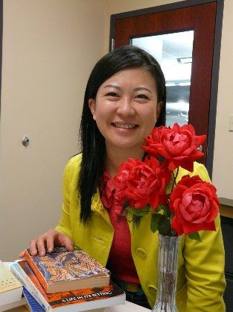


# About Us
WHO WE ARE
Ning Zou
MG Prezioso
Dylan J. Lukes
Associate Director for Student Academic Services & Learning Design and a research librarian. She oversees Gutman Library's Writing Services and the Communications Lab in addition to providing research consultations and leading the library's learning design projects
Doctoral candidate at Harvard University and HGSE. MG studies the intersection of psychology and literature. Specifically, she is interested in the process of children's narrative absorption, as well as how literature contributes to students' moral development and identity formation.
Doctoral candidate and Presidential Scholar at Harvard University and HGSE. He studies the economics of education with a focus on technology and learning.
https://communicate.gse.harvard.edu/communicationslab

Slide 4
# PRESENTATION BASICS
WORKSHOP AGENDA
01
02
PRESENTATION DO’S AND DON’T
INTRO TO STORYBOARDING
03
04
INTRO TO SLIDE BUILDING
PRACTICE, PRACTICE, PRACTICE

Slide 5
# PRESENTATION BASICS
WORKSHOP AGENDA
01
02
PRESENTATION DO’S AND DON’T
INTRO TO STORYBOARDING
03
04
INTRO TO SLIDE BUILDING
PRACTICE, PRACTICE, PRACTICE

Slide 6

# PRESENTATION DO’S AND DON’T
DO #1
“Structure Your Deck”
Scalable
  Opening
  Arguments with supporting details
  Closing
Deck Structures
  Problem -> Pathway -> Solution
  Problem -> Solution -> Reasoning
Problem -> Pathway -> Solution
Title
here

Slide 7
# PRESENTATION DO’S AND DON’T
DO #2
“Visualize Your Idea”
Embrace PowerPoints Strengths
  Multimedia – pictures, videos, text
  “A picture is worth a 1,000 words”
Types of Visualizations
  Pictures
  Diagrams / Frameworks
  Graphs
  Others
Title
here

Slide 8
# PRESENTATION DO’S AND DON’T
DO #3
“Be Consistent”
Color Scheme – Pick One & Stick With It
  Use but a few matching colors
  Embrace color gradients
Deck Themes – Pick One & Stick With It
  Power-User add-in
  SlideModel
  Envato Elements
Fonts
Title
here

Slide 9
# PRESENTATION DO’S AND DON’T
DO #4
“Solicit Feedback”
Deck Outline
  Agree on outline before drafting slides on paper
  Importance of storyboarding
Slide Designs
  Design first via rough sketches
  Highlight particularly troublesome slides OR particularly important
Presentation – Proofread & Practice!
Title
here

Slide 10
# PRESENTATION DO’S AND DON’T
DO #5
“Use Backups”
Email
Cloud
  OneDrive
  Google Docs
USB / External Hard Drive
Ctrl + S is your friend – Version Control
Title
here

Slide 11

# PRESENTATION DO’S AND DON’T
DON’T #1
“Overload Slides”
Text
  All text slides are a quick and surefire way to lose your audience
  Avoid long paragraphs and excessive bullet points
Graphs
Key Points
  Stick to 1 key point per slide
  Don’t overwhelm the audience

Slide 12
# PRESENTATION DO’S AND DON’T
DON’T #2
“Read Word-For-Word”
Word-for-Word Reading
  The audience can read faster than you can talk
  Boring – great way to lose your audience’s attention
  May indicate a lack of preparation
If needed, create presentation notes for your eyes only

Slide 13
# PRESENTATION DO’S AND DON’T
DON’T #3
“Use ClipArt”
This often looks unprofessional
  Know your audience
Avoid copyright infringement – using Google searched images
Freely Usable Image Repositories
  Unsplash
  Burst
  Pixabay
  Others

Slide 14
# PRESENTATION DO’S AND DON’T
DON’T #4
“Wing It”
Practice, Practice, Practice
  With others
  By yourself
Use slides notes if this helps
Be rehearsed and polished, but not overly so
  Sharp and professional
  BUT don’t be a robot

Slide 15
# PRESENTATION DO’S AND DON’T
DON’T #5
“Use Filler Words”
Avoid “Ums”, “Ohs”, “Erms”
  This is tough!
  Gets better with practice
Pauses are okay
Find a speaking cadence you feel comfortable and project confidence
Check-in with your audience

Slide 16

DO #1
DO #2
# PRESENTATION DO’S AND DON’T
SUMMARY
PRESENTATION DO’S
Structure Your Deck
Visualize Your Ideas
Embrace these quick wins and you’re well on your way to having professional slides that are client friendly and succinctly communicate key points while keeping the audience engaged
DO #3
Be Consistent
DO #5
Use Backups
DO #4
Solicit Feedback

Slide 17

# PRESENTATION DO’S AND DON’T
DON’T #1
DON’T #2
SUMMARY
PRESENTATION DONT’S
Overload Slides
Read Word-for-Word
Avoid these common pitfalls and you’re well on your way to having professional slides that are client friendly and succinctly communicate key points while keeping the audience engaged
DON’T #3
Use ClipArt
DON’T #5
Use Filler Words
DON’T #4
Wing-It

Slide 18
# PRESENTATION BASICS
WORKSHOP AGENDA
01
02
PRESENTATION DO’S AND DON’T
INTRO TO STORYBOARDING
03
04
INTRO TO SLIDE BUILDING
PRACTICE, PRACTICE, PRACTICE

Slide 19

# INTRO TO STORYBOARDING
STORYBOARDING
WHAT IS IT?
PLANNING
A high-level outline of your deck
  Captures key messages and overarching thought of your presentation
Contains supporting messages and details
First and essential step of mapping your ideas to PowerPoint
Pencil-Paper Draft
  Key Message -> Supporting Message -> Supporting Details
UX ENGENEER
Ut et pulvinar odio. Nam condimentum nisl

Slide 20
# INTRO TO STORYBOARDING
STORYBOARDING
WHY DO IT?
PLANNING
Planning before doing
  Foundation of your deck
  Need to know what you’re going to do before you do it
Helps one craft a presentation that coherent with slides that tie together
Clarify and sharpen language/content
Thinking stage – quite possibly the most important step in designing and creating an effective and professional deck
UX ENGENEER
Ut et pulvinar odio. Nam condimentum nisl

Slide 21
# INTRO TO STORYBOARDING
STORYBOARDING IN 3 STEPS
1
2
3
DRAFT AN OUTLINE
DRAW SLIDES
TRANSITION TO POWERPOINT
Key Message
Supporting Messages
Supporting facts, details and anecdotes
Build in deck logic and map out slide sections
Transition your words from your outline into PowerPoint slides
Draw them out – create rough sketches of what you what each slide to look like
Transform your rough sketches from your “wire-frame” into real slides in PowerPoint
Choose a deck template and stick with it
Don’t recreate the wheel - leverage prefab slides or old slides

Slide 22

# INTRO TO STORYBOARDING
Create An Outline
Key Message
What are you trying to say?
One key point
Supporting Message
Directly tied to key message
Subpoints
Supporting Details
Graphs, figures, data, etc.
Key Message 1
  Support Message 1
    Supporting Detail
    Supporting Detail
  Support Message 2
    Supporting Detail
    Supporting Detail
Key Message 2
  Support Message 1
    Supporting Detail
    Supporting Detail
  Support Message 2
    Supporting Detail
    Supporting Detail
^{A}
STEP 1
Draft An
Outline
Essential first step to having an organized, coherent, easy to follow and high impact presentation
B
Get Feedback
“A stitch in time saves nine”
From team members/colleagues
Get sign-off on key ideas before moving to slide creation

Slide 23


Key Message 1
  Support Message 1
    Supporting Detail
    Supporting Detail
  Support Message 2
    Supporting Detail
    Supporting Detail
Key Message 2
  Support Message 1
    Supporting Detail
    Supporting Detail
  Support Message 2
    Supporting Detail
    Supporting Detail
# INTRO TO STORYBOARDING
STEP 2
Draw Slides
Convert your written outline to paper/pencil slide drafts. Drawing skills useful but absolutely not required.

Slide 24

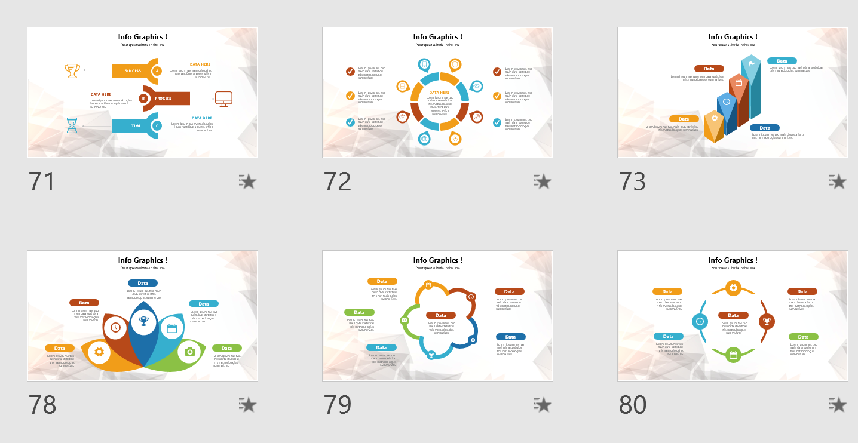
# INTRO TO STORYBOARDING
STEP 3
Transition to
PowerPoint
This is the final step. Use your outline and drawn slides to guide your deck creation in PowerPoint. The hard thinking is done. Now the fun begins.

Slide 25
# PRESENTATION BASICS
WORKSHOP AGENDA
01
02
PRESENTATION DO’S AND DON’T
INTRO TO STORYBOARDING
03
04
INTRO TO SLIDE BUILDING
PRACTICE, PRACTICE, PRACTICE

Slide 26
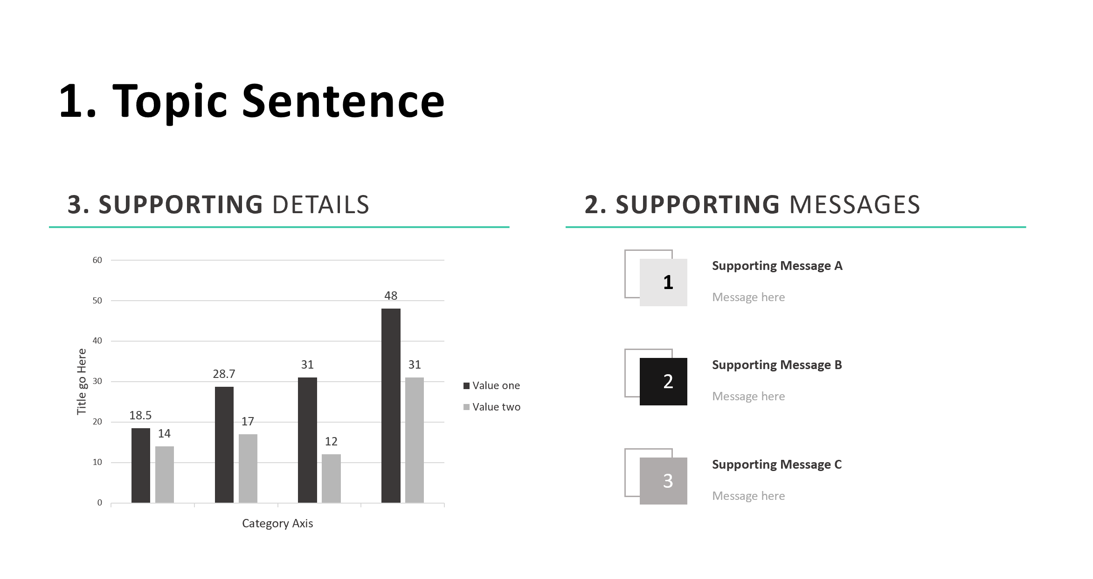
# INTRO TO SLIDE BUILDING
Slide 101: Components
Example Template
1
Topic Sentence
2
Supporting Arguments
3
Supporting Details

Slide 27
# INTRO TO SLIDE BUILDING
What Makes A Good Topic Sentence?
1
Concise
Should only be 1-2 sentences
Be Specific
“During the 1980s, Australia became the world’s largest producer of diamonds”
2
Clear
One key message – highlight the main takeaway
“During the 1980s, Australia became the world’s largest producer of diamonds and has the single largest mine in the world which produces 34 million carats a year. Their largest mining pipe is Argyle mine”
3
Insightful
Tells the reader something they didn’t know or see
“Diamonds in Australia”
4
Readable
Not wordy – untechnical, avoids data dumps
Source: Alley, M., Schreiber, M., Ramsdell, K., & Muffo, J. (2006). How the design of headlines in presentation slides affects audience retention. Technical Communication, 53(2), 225-234.

Slide 28
# PRESENTATION BASICS
WORKSHOP AGENDA
01
02
PRESENTATION DO’S AND DON’T
INTRO TO STORYBOARDING
03
04
INTRO TO SLIDE BUILDING
PRACTICE, PRACTICE, PRACITCE

Slide 29

# PRACTICE, PRACTICE, PRACTICE
PRACTICE EXAMPLE
What Causes Color in Diamonds?
Fancy colors are rare
Colors come from impurities or defects
Examples:
Yellow: nitrogen
Blue: boron
Green: uranium (irradiation)
Red/Pink: unknown
1
Create Your Slide Outline
Main Sentence
Supporting Messages
Supporting Details
2
Draw Your Slide
Transition your written outline to an actual slide
Remember slide structure!
3
Create Your Slide in PowerPoint
Final Step
Transfer your drawn slide to PowerPoint!
Source: Alley, M., Schreiber, M., Ramsdell, K., & Muffo, J. (2006). How the design of headlines in presentation slides affects audience retention. Technical Communication, 53(2), 225-234.

Slide 30
# PRACTICE, PRACTICE, PRACTICE
What causes color in diamonds?
Fancy colors are rare
Colors come from impurities or defects
Examples:
  Yellow: nitrogen
  Blue: boron
  Green: uranium (irradiation)
  Red/Pink: unknown
Source: Alley, M., Schreiber, M., Ramsdell, K., & Muffo, J. (2006). How the design of headlines in presentation slides affects audience retention. Technical Communication, 53(2), 225-234.

Slide 31

# PRACTICE, PRACTICE, PRACTICE
In diamonds, rare colors come from impurities, defects and irradiation.
Colors & Impurities
1
Yellow: Nitrogen
Blue: Boron
Green: Uranium (irradiation)
Red/Pink: Unknown
2
3
4
Source: Alley, M., Schreiber, M., Ramsdell, K., & Muffo, J. (2006). How the design of headlines in presentation slides affects audience retention. Technical Communication, 53(2), 225-234.

Slide 32
THANK YOU
# HGSE COMMUNICATIONS LAB
https://communicate.gse.harvard.edu/communicationslab

