Slide 1
The Communications Lab @ HGSE Presents…
“Posterize” Your Poster:
How to Create and Give an Effective Poster Presentation
March 2022
Notes:
If webinar, try and do a poll of students before starting:
What’s your concentration?
Why did you attend?

Slide 2



# ABOUT US
WHAT
WE DO
We are a HGSE resource created to help graduate students develop their presentation skills and to provide a space and opportunity for students to cultivate their oral and visual communication skills
1
2
3
Workshops
Webinars
Consultations
Note: Photos included in this presentation are from Unsplash.com and Flickr.com. Unsplash is a free online service that provides professional quality photos which can be used for commercial or non-commercial purposes without the need of permission or credit. Flickr.com is a photograph management and sharing website. Note that only some photographs on Flickr can be used without permission; be sure to check each photograph’s individual copyright information.

Slide 3
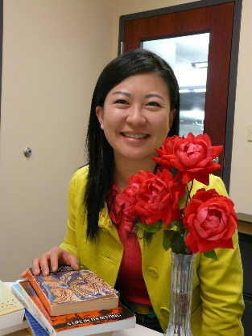

# About Us
WHO WE ARE
Ning Zou
MG Prezioso
Associate Director for Student Academic Services & Learning Design and a research librarian. She oversees Gutman Library's Writing Services and the Communications Lab in addition to providing research consultations and leading the library's learning design projects
Doctoral candidate at Harvard University and HGSE. MG studies the intersection of psychology and literature. Specifically, she is interested in the process of children's narrative absorption, as well as how literature contributes to students' moral development and identity formation.
https://communicate.gse.harvard.edu/communicationslab

Slide 4
# EFFECTIVE POSTER PRESENTATIONS
WORKSHOP AGENDA
01
02
INTRO TO RESEARCH POSTERS
CREATE YOUR POSTER
03
04
PRESENTATION DOS & DON’TS
EXAMPLE & RESOURCES

Slide 5
# EFFECTIVE POSTER PRESENTATIONS
WORKSHOP AGENDA
01
02
INTRO TO RESEARCH POSTERS
CREATE YOUR POSTER
03
04
PRESENTATION DOS & DON’TS
EXAMPLE & RESOURCES

Slide 6
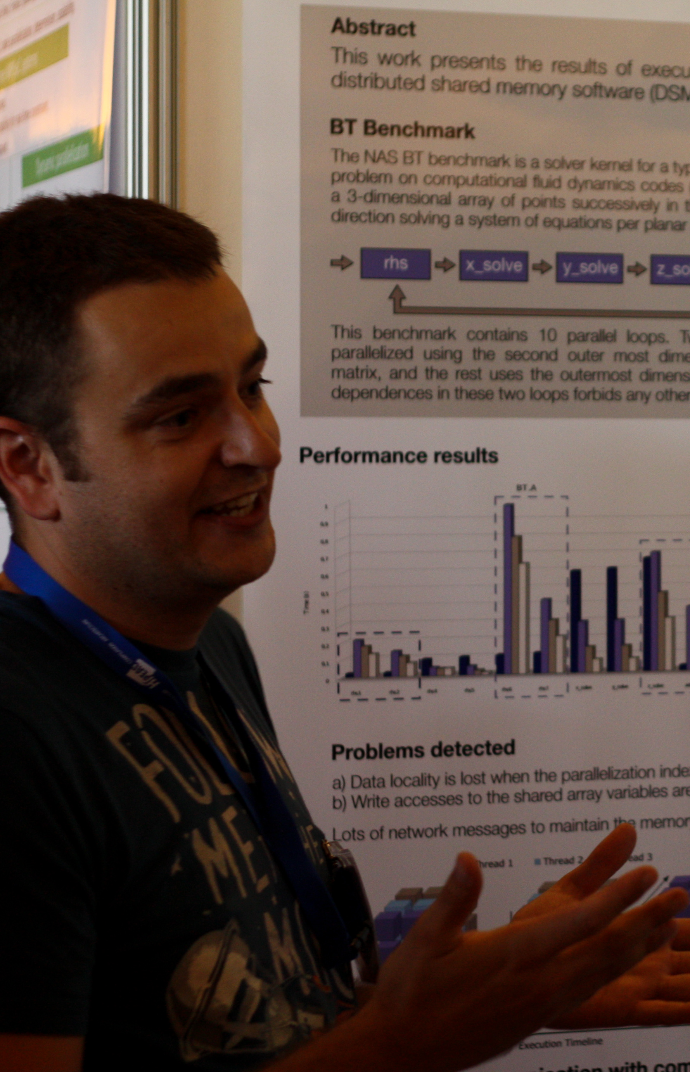

# INTRO TO RESEARCH POSTERS
WHAT IS A
RESEARCH POSTER?
PLANNING
Concise summary of information to publicize your work and generate discussion
  Content is a mix of text and figures
  Includes graphs, charts, tables, etc.
  Visually appealing
Researcher stands by the display
  Other participants view presentation and interact with author
UX ENGENEER
Ut et pulvinar odio. Nam condimentum nisl
Notes:
Poster basics

Slide 7
# INTRO TO RESEARCH POSTERS
ACADEMIC CONFERENCE
POSTER SESSIONS
PLANNING
All major conferences have poster sessions
  Often used to showcase early stage work
Opportunity to present yourself and your ideas
  Gain experience presenting
  Networking opportunity
  Participants may be future collaborators, colleagues or employers
UX ENGENEER
Ut et pulvinar odio. Nam condimentum nisl

Slide 8
# INTRO TO RESEARCH POSTERS
POSTER BASICS
PLANNING
Typical poster sizes
  18" x 24" for easel signs
  36" x 48" for medium size posters
  48" x 60" for large posters
Word count
  800 – 1000 words total
  This includes labels describing figures and graphs
Font
  At least 20pt. Titles and headings 40-50pt font
  Should be readable from 3-5 feet away
UX ENGENEER
Ut et pulvinar odio. Nam condimentum nisl

Slide 9
# EFFECTIVE POSTER PRESENTATIONS
WORKSHOP AGENDA
01
02
INTRO TO RESEARCH POSTERS
CREATE YOUR POSTER
03
04
PRESENTATION DOS & DON’TS
EXAMPLE & RESOURCES

Slide 10
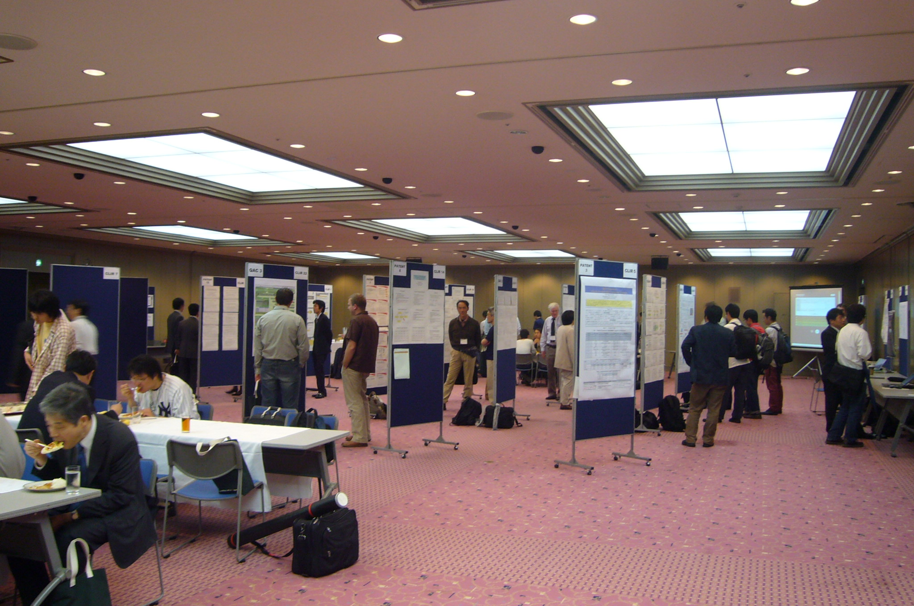
# CREATE YOUR POSTER
YOUR POSTER IN 5 STEPS
1
2
3
4
5
PREPARE
ORGANIZE
DESIGN FOR IMPACT
CREATE
PRINT
What is the most important or interesting finding from your research?
Consider your audience and conference requirements
Organize your information
Be brief and concise—this is not a journal article or paper
How can you visually share your research?
Use graphs, figures, charts, and images
Find an online template or create your own
Multiple software options
Professional printing for conferences
Trifold with print outs may be sufficient for course poster sessions
Notes:
* Poster Design

Slide 11

WHO IS YOUR AUDIENCE?
Effective communication begins by knowing your audience
Are you presenting to academics, colleagues, and/or practitioners?
# DESIGNING FOR IMPACT
ª
STEP 1
PREPARE
WHAT IS YOUR KEY FINDING?
What is the one thing you most want people to know after viewing your poster?
Develop a key focus item (e.g., figure, graph, statement) to represent this
^{b}
This is an essential first step to designing and delivering an effective poster presentation.
WHAT ARE THE REQUIREMENTS?
Know the expectations in terms of poster size and formatting
^{c}

Slide 12
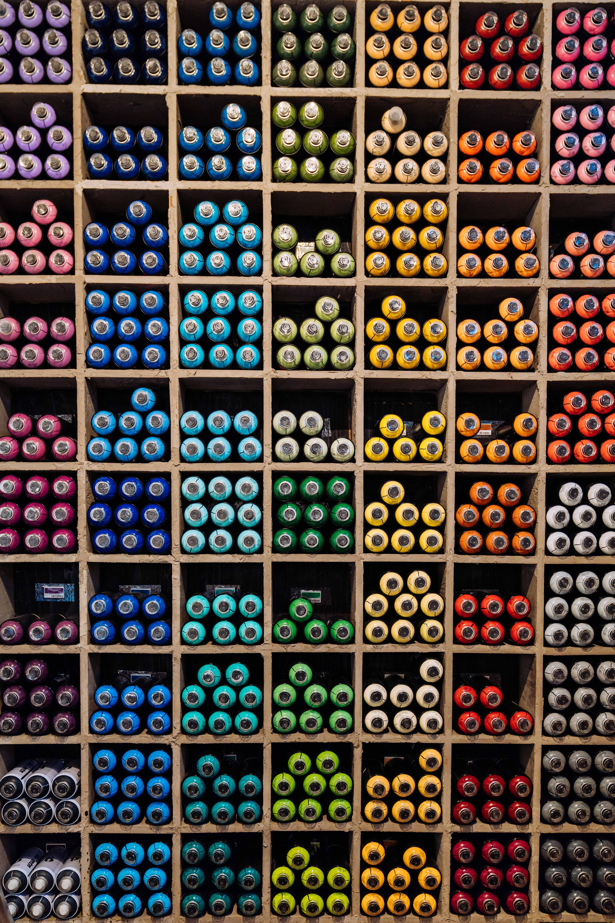
SAMPLE LAYOUT
# DESIGNING FOR IMPACT
STEP 2
ORGANIZE
Decide how you will group the information you want to share. Research posters have typical sections; although, some variation is normal.
Poster template from: https://colinpurrington.com/tips/poster-design. This template and others are downloadable.
Notes:
1) Harvard Shields – contact someone to get GSE shield; simply use university shield

Slide 13

VISUALS
Whenever possible, use figures instead of text
Display main results in a carefully designed figure
Fonts and colors should be consistent
Web images may be pixelated when enlarged
# DESIGNING FOR IMPACT
ª
STEP 3
DESIGN FOR IMPACT
USE PHRASES FOR HEADINGS
Title should hint at conclusion
For Results Section and Figures, us short phrases that convey key information as your headings
^{b}
Careful design of your poster will help you achieve maximum impact. Graphics, layout, colors, and fonts should all be carefully selected.
LEAVE SPACE
A cramped poster is hard to read
Leave white space and align text and images
Use lists instead of blocks of texts
^{c}

Slide 14

POSTER TEMPLATES
Many online sites with downloadable templates
# DESIGNING FOR IMPACT
ª
STEP 4
CREATE
CREATE YOUR OWN
Posters can be designed in various software applications
PowerPoint, LaTex, InDesign, etc.
^{b}
Posters can be created using existing online templates or by creating your own layout in a software program of your choice.
WORKING IN POWERPOINT
Poster size (in inches) can be customized in Page Setup
Create your own template using text boxes
^{c}
Notes:
Programs: .pptx -> save to pdf; LaTex

Slide 15

PROOFREAD
Print out a single page version
Review and get feedback from others
Save as PDF for printing
# DESIGNING FOR IMPACT
ª
STEP 5
PRINT
PROFESSIONAL PRINTING
On-campus or private printing – two options: paper or fabric
Paper requires transport in a tube
Fabric can be folded and packed in luggage
^{b}
There are several options for printing and displaying your poster. Factors to consider are cost, transport, and setting.
CONSIDER A TRIFOLD
Attach printouts to a poster board
More affordable option for class presentations
^{c}
Notes:
Trifold – best for less formal class requirements – save $
Printing – Lamont or Molecular Biology;
Type: cloth (fold up – does crease, could possibly steam/iron) vs. roll-up

Slide 16
# EFFECTIVE POSTER PRESENTATIONS
WORKSHOP AGENDA
01
02
INTRO TO RESEARCH POSTERS
CREATE YOUR POSTER
03
04
PRESENTATION DOS & DON’TS
EXAMPLE & RESOURCES

Slide 17

# POSTER DOS & DON’TS
DO #1
Prepare Remarks
Title
here
Succinct description of your research
  Designed to engage audience
Use a “hook”
  Provocative statement
  Ask a question
Notes:
* Presentation dos/don’t
* More about presentation of poster, less about design

Slide 18
# POSTER DOS & DON’TS
DO #2
Be Passionate
Title
here
Does your verbal description convey your work’s import?
  Good content and design may not be enough
If you’re not excited, your listener probably won’t be either

Slide 19
# POSTER DOS & DON’TS
DO #3
Engage Your Audience
Title
here
Introduce yourself
Invite questions or feedback
Share your contact information
  Include it on your poster
  Bring business cards
Bring a notepad
  For taking notes, jotting down ideas
Problem -> Pathway -> Solution

Slide 20
# POSTER DOS & DON’TS
DO #4
Anticipate Questions
Title
here
Brainstorm potential questions
  Solicit help from colleagues/friends
Be up-to-date on relevant recent research

Slide 21
# POSTER DOS & DON’TS
DO #5
Be Confident
Title
here
Hone your non-verbal communication
  Stance
  Posture
  Eye contact
Nerves
  Being nervous ≠ lacking confidence
  Poster sessions are a good option for those who are less comfortable presenting to large groups

Slide 22

# POSTER DOS & DON’TS
DON’T #1
“Wing” It
Practice, Practice, Practice
  With others
  By yourself
Be rehearsed and polished, but not overly so
  Sharp and professional
  BUT don’t be a robot. It’s a conversation.

Slide 23
# POSTER DOS & DON’TS
DON’T #2
Use Notes
Don’t read word-for-word from your poster
  The audience can read faster than you can talk
  Boring – great way to lose participants’ attention
Do use notes or an outline to develop your remarks

Slide 24
# POSTER DOS & DON’TS
DON’T #3
Block Your Poster
Stand to one side
  This allows people to read it
  If you’re presenting as a group, make sure there’s enough space for everyone
Use your fingers to point out parts of your poster
  Your poster is a visual aid

Slide 25
# POSTER DOS & DON’TS
DON’T #4
Plagiarize
Written text and visuals should be your own
  Cite others’ work appropriately
  Credit co-authors, contributors, funders, etc.
Avoid copyright infringement with any images

Slide 26
# POSTER DOS & DON’TS
DON’T #5
Forget …
Water
  Poster sessions can be loud and noisy
  You’ll have to project your voice
Comfortable shoes
  You’ll be standing for several hours
To arrive early
  Give yourself time to get set up
  Get comfortable in your space

Slide 27
# EFFECTIVE POSTER PRESENTATIONS
WORKSHOP AGENDA
01
02
INTRO TO RESEARCH POSTERS
CREATE YOUR POSTER
03
04
PRESENTATION DOS & DON’TS
EXAMPLE & RESOURCES

Slide 28
EXAMPLE

Slide 29
Strengths
Clear organization
Text boxes are aligned
Includes white space
Consistent fonts and color scheme
Weaknesses
Graph or figure rather than table of results
Introduction is text heavy
More catchy title/headings
EXAMPLE

Slide 30
Resources
Harvard Shields
University shield: https://guidelines.hwp.harvard.edu/veritas-and-school-shields
School shields: https://guidelines.hwp.harvard.edu/school-shields
On-Campus Poster Printing
Lamont Library Media Lab: https://library.harvard.edu/services-tools/large-format-printing,
Department of Molecular Biology: https://mcbgraphics.fas.harvard.edu/
Poster Templates
Colin Purrington: https://colinpurrington.com/tips/poster-design/
Overleaf: https://www.overleaf.com/gallery/tagged/poster
Notes:
1) Harvard Shields – contact someone to get GSE shield; simply use university shield
2) Printing – Lamont or Molecular Biology;
3) Type: cloth (fold up – does crease, could possibly steam/iron) vs. roll-up
4) Programs: .pptx -> save to pdf; LaTex

Slide 31
THANK YOU
#HGSE COMMUNICATIONS LAB
https://communicate.gse.harvard.edu/communicationslab

Slide 32
References
NYU Libraries (2020, January 2). How to create a research poster: Poster basics. https://guides.nyu.edu/posters
Purrington, Colin (2019). Designing conference posters. Accessed https://colinpurrington.com/tips/poster-design/
University of Guelph Teaching Support Services (n.d.). Effective poster design. Accessed from: http://www.soe.uoguelph.ca/webfiles/agalvez/poster/
University of Cincinnati (2016). Creating poster presentations using Power Point 2010. Accessed from: https://grad.uc.edu/content/dam/refresh/grad-62/docs/prof-devel/expo/Creating-Poster-Presentations-Using-PowerPoint-2010.pdf

